Slide 1

Stream Monitoring 101
with the Clinton River Watershed Council

Slide 2
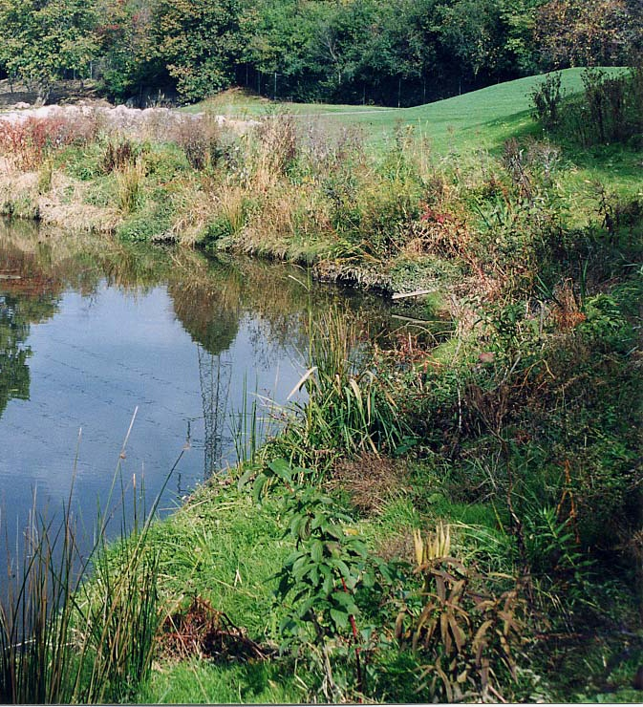

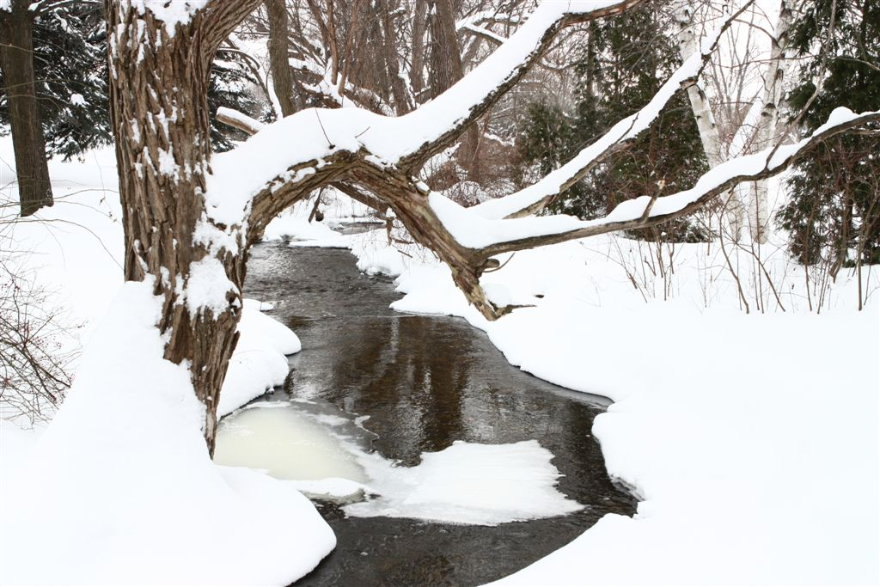
MISSION
Clinton River Watershed Council
To protect, enhance, and celebrate the Clinton River, its watershed, and Lake St. Clair
Non-profit organization
Supported by grants, individual membership, community membership, donations
Education
Stewardship
Watershed management
Photos by: John Meyland

Slide 3
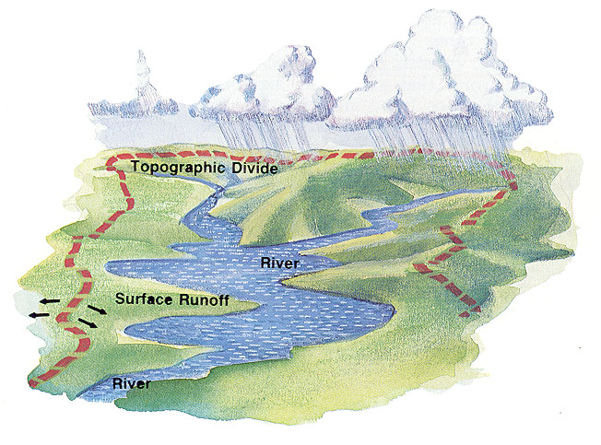
The region draining into a river, river system, or other body of water.
What is a Watershed?

Slide 4
What’s IN a Watershed?
Precipitation
Snowpack
Groundwater flow
Runoff – stormwater
Lakes
Tributaries
Forests
Farmland
Homes
Roads
Business
Factories

Slide 5
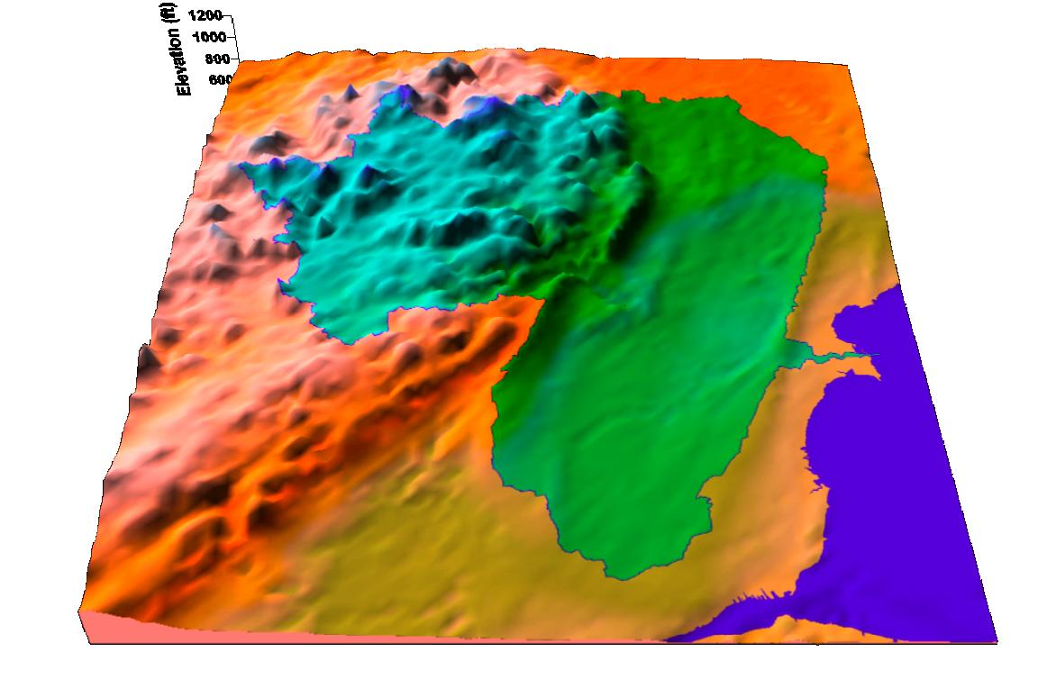
Geography of the Watershed
Notes:
This shows us a little bit of the geography of the Clinton River Watershed.

Slide 6
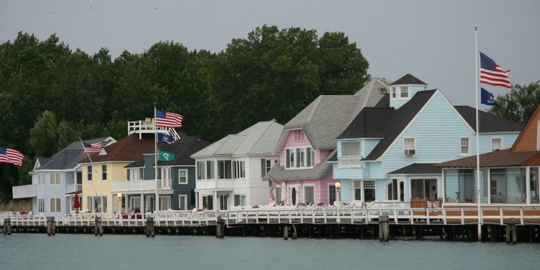
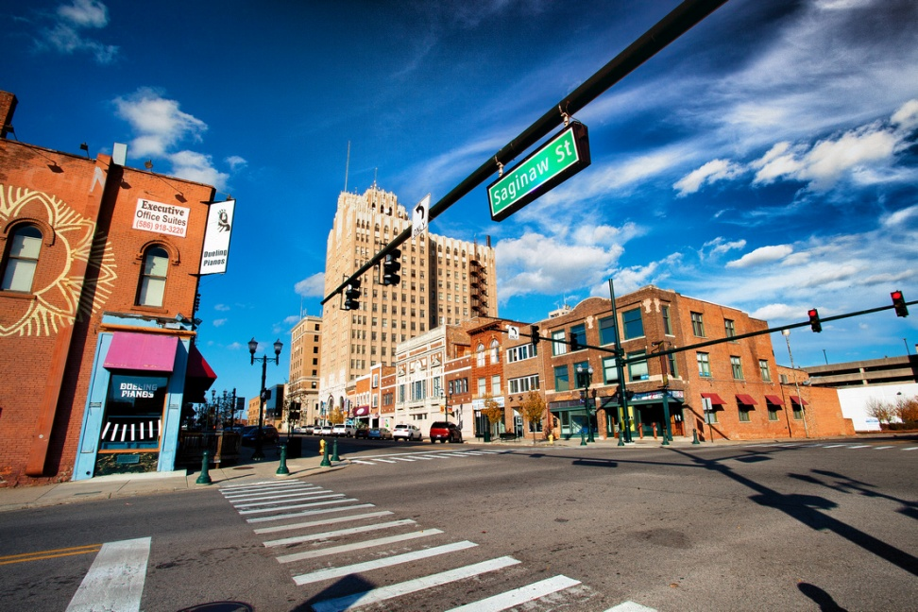
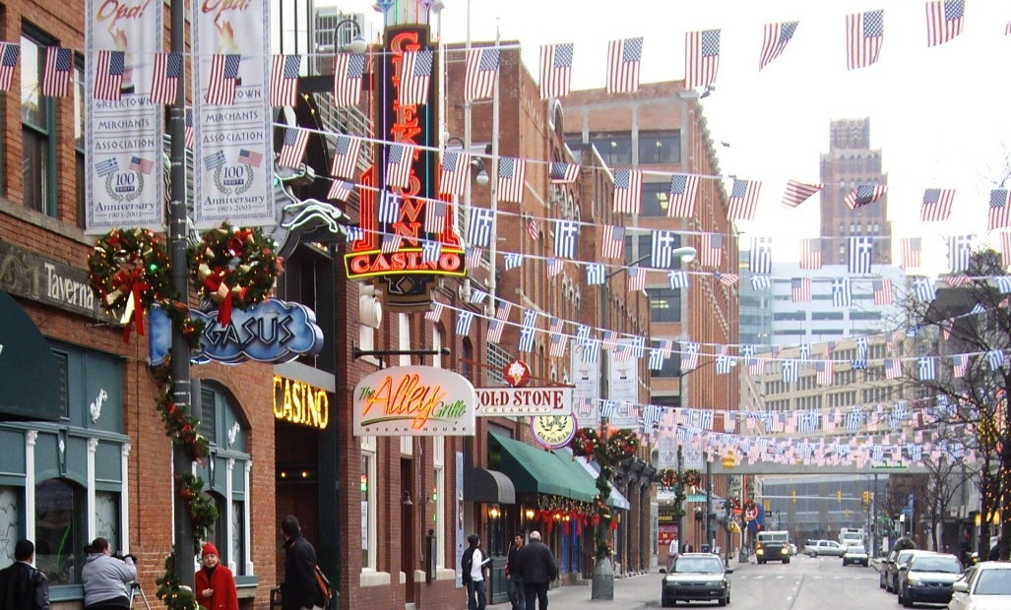
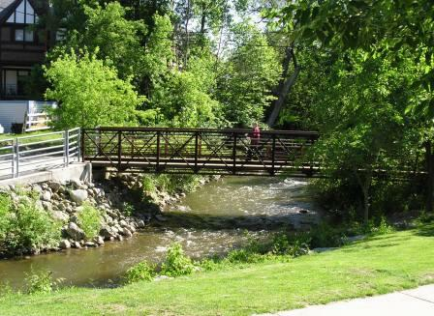
No matter where you live, you live in a watershed!

Slide 7
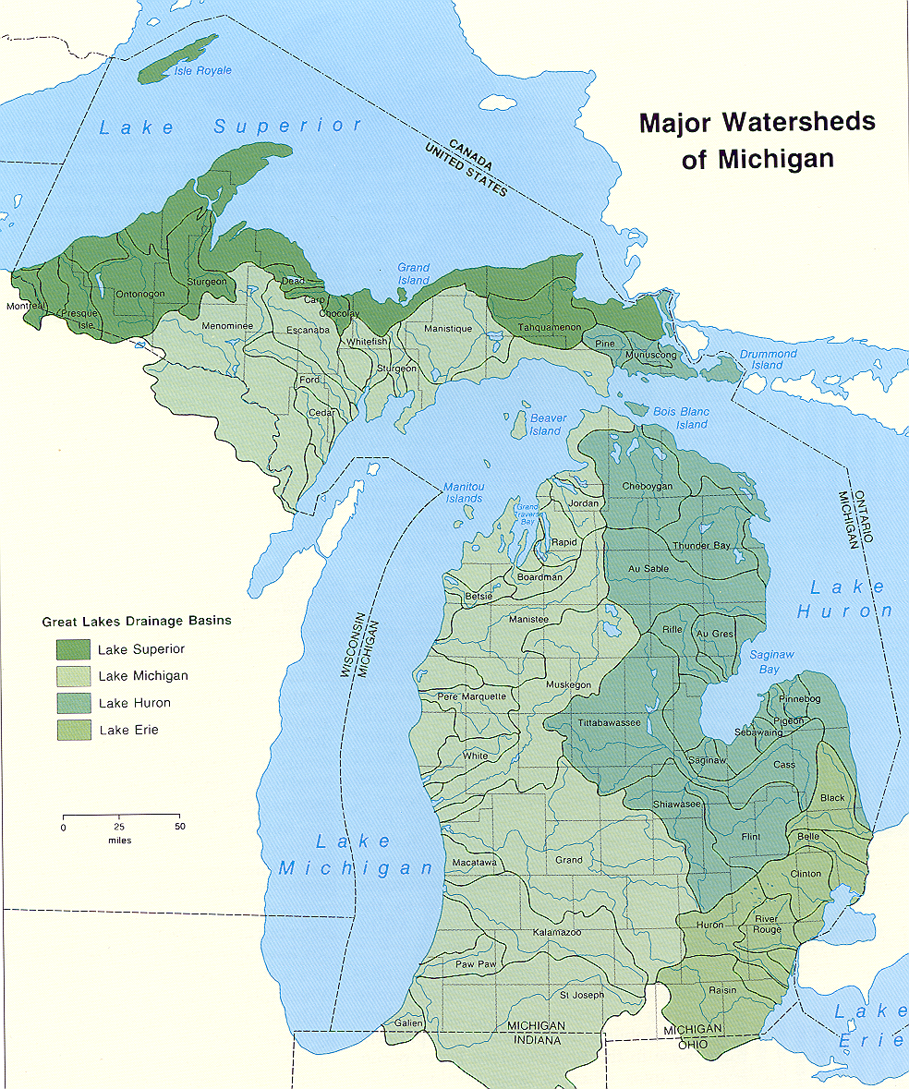
What watershed do you live in?
The Clinton!
Notes:
The Clinton!!!

Slide 8
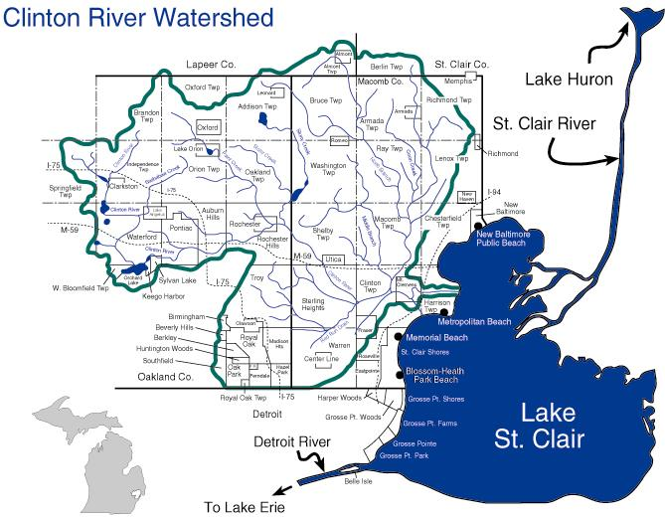
Rural / Residential
Rapidly Urbanizing
Urbanized

Slide 9
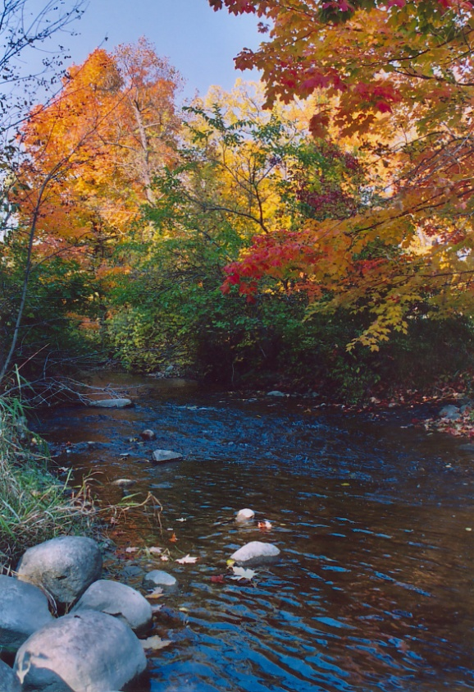
About the Clinton River Watershed
760 square mile watershed
Portions of Lapeer, Macomb, Oakland & St. Clair counties
More than 60 communities
1.5 million people – most populous watershed in Michigan

Slide 10
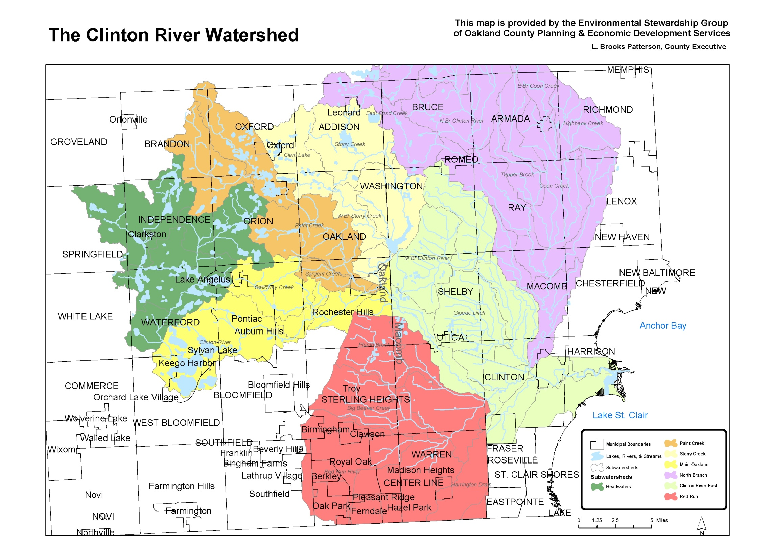
Major Subwatersheds
Paint Creek
Stony
Creek
North Branch
Upper
Clinton
ClintonMain
Clinton River East
Rouge
River
Watershed
Red Run
Notes:
The Clinton River Watershed Council is divided into 7 Subwatersheds.

Slide 11
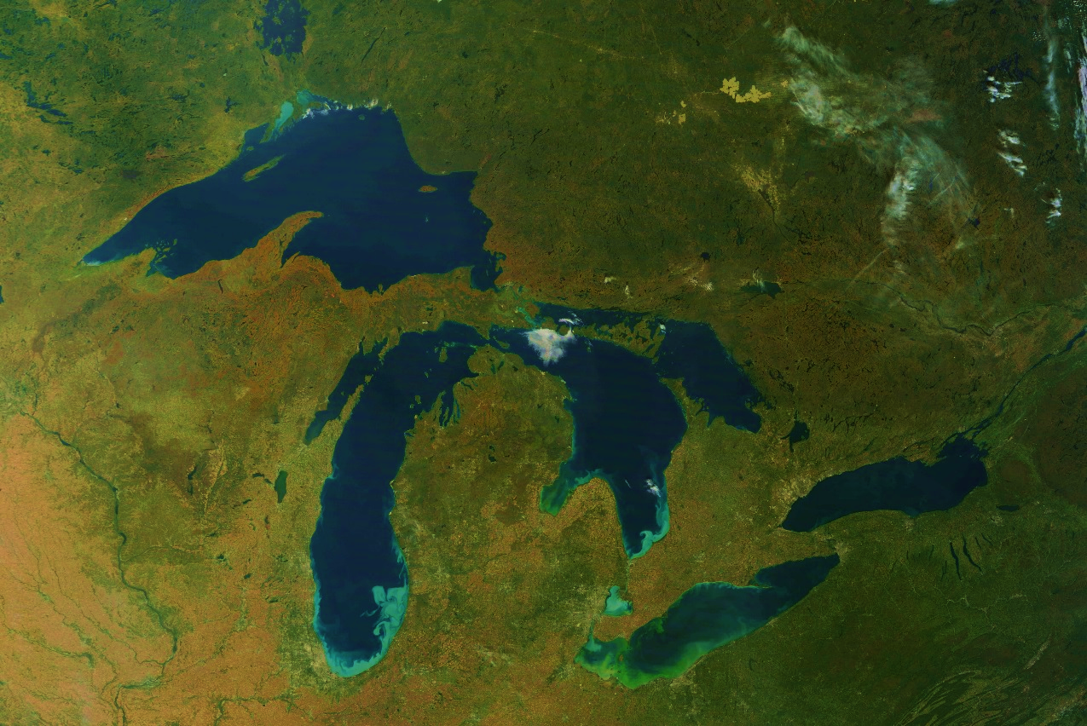
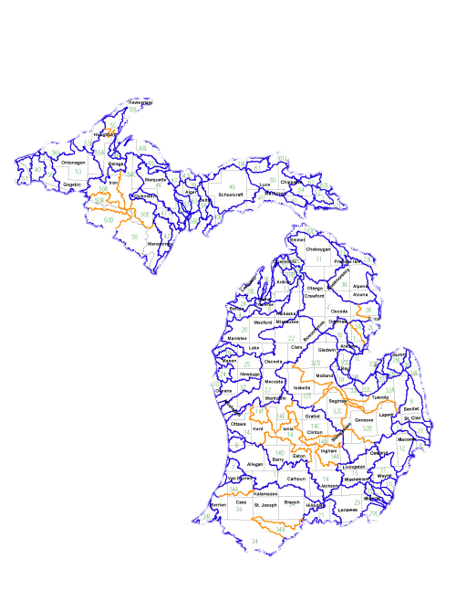
About the Great Lakes Region
We are surrounded by precious fresh water
Hold estimated 6 quadrillion gallons of water
Could cover the contiguous U.S. (48 States) with 9.5 ft. of water
Approximately one-fifth of world’s freshwater
90% of U.S. freshwater
3,288 miles of shoreline – more than Florida (1,197) and California (840)
94,000 square miles of water, drain twice as much land – Great Lakes Basin
WE ARE CONNECTED

Slide 12
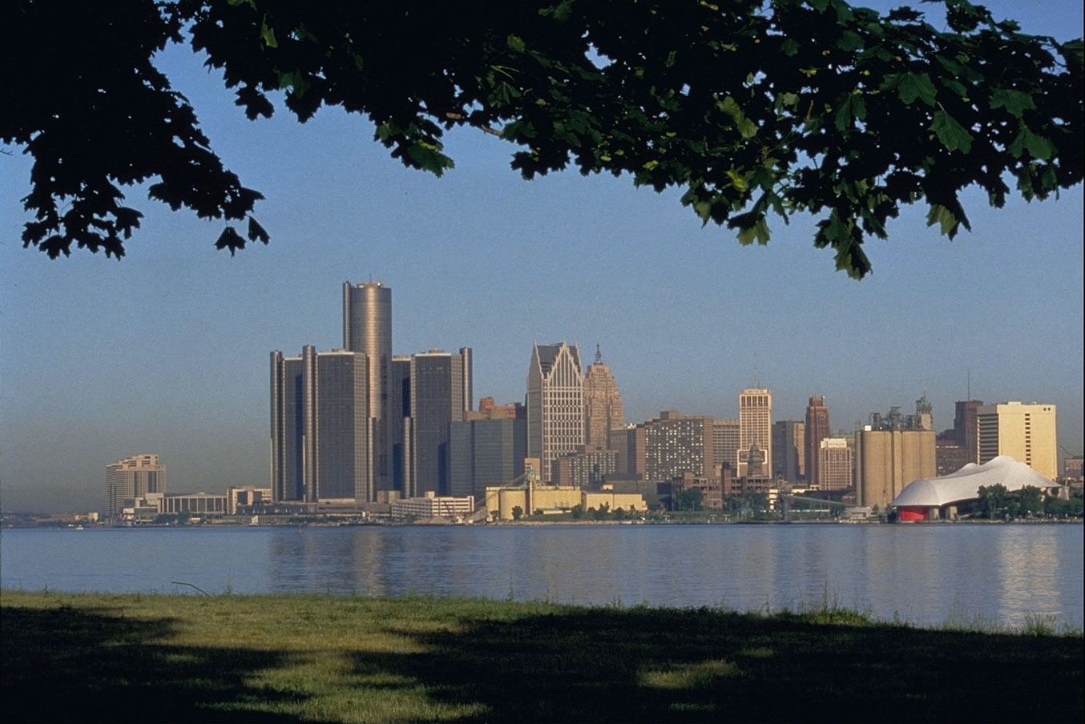
Why do we care about the health of our rivers?

Slide 13
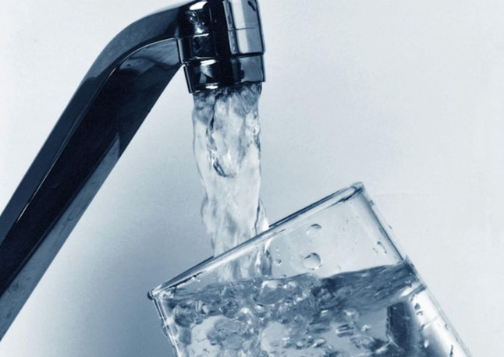
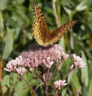
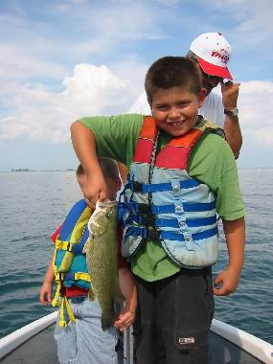
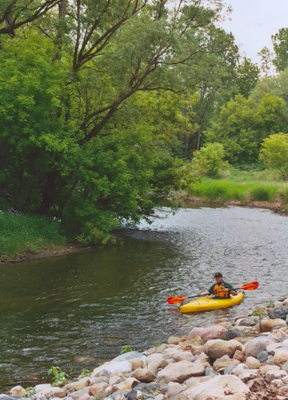
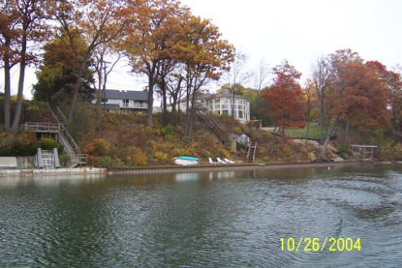
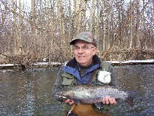
Drinking Water
Recreation – 3rd largest marine industry
Economics – fishing, boating, tourism
Major local rivers – Huron, Rouge, Clinton
Steelhead Fishery
Scenic River Trails & Vistas
Local History
Place We Call Home
But threats exist…

Slide 14
Who affects the health of the river?
Industry?
Individuals ?

Slide 15
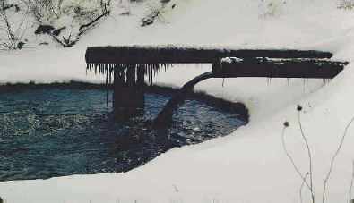
Point source pollution can be traced back to a specific location, such as a pipe or disposal site.
CWA - 1972

Slide 16
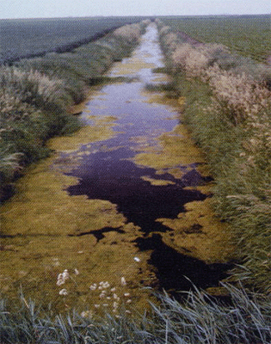
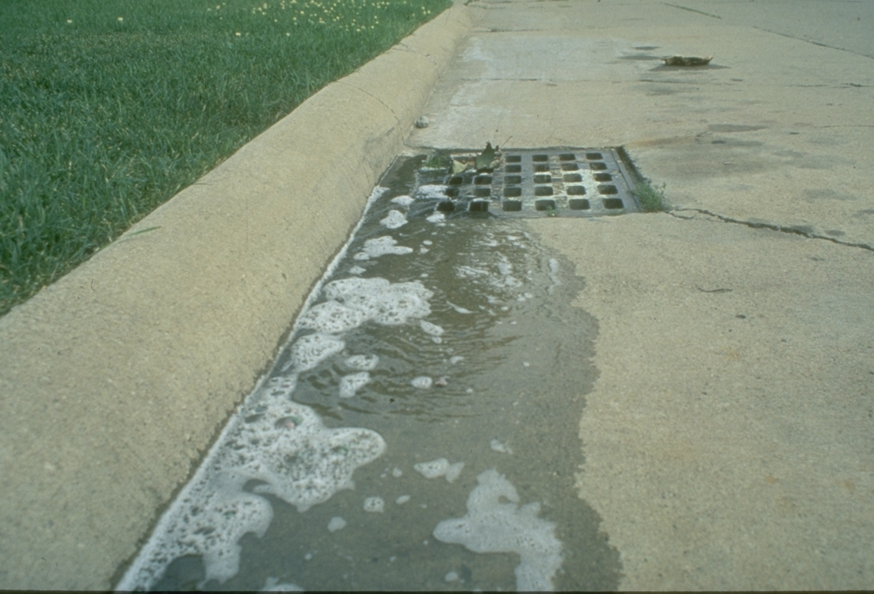
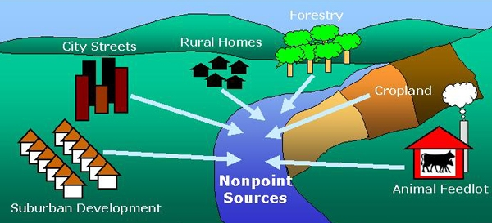
Non-point source pollution is harder to trace.
Notes:
Large amounts of pollution are carried by storm water runoff, or the water that runs over the ground during a rainstorm,and directly into the River. Storm water picks up pollutants in the form of fertilizers pesticides oil and various chemicals and bacteria from animal waste . The storm water flows through storm drains into the Clinton River without treatment. Therefore , the health of the river is affected by activities in the entire watershed.

Slide 17
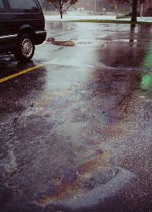
River
Water Quality
STORMWATER
POLLUTION
Historical Water Quality Problems:
  Contaminated sediments
  Industrial & municipal discharges
  Flooding
Current Water Quality Problems:
  Bacterial contamination from sewer overflows and failing septic systems
  Contaminated sediments persist
  But what is the single greatest source of impairments in the our local major rivers?

Slide 18
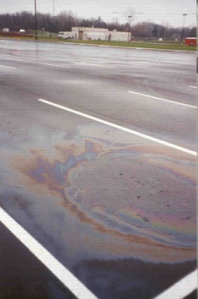
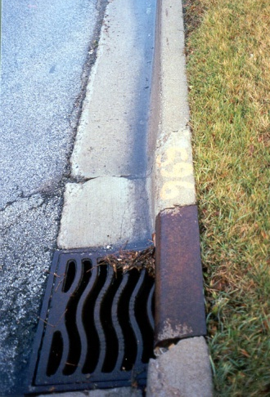
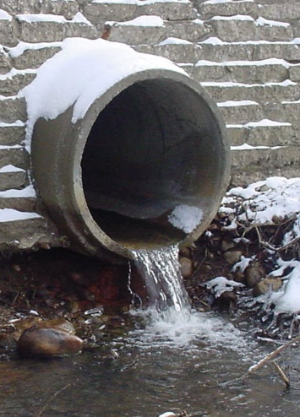
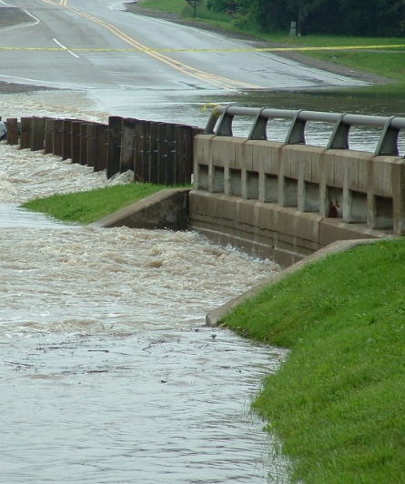
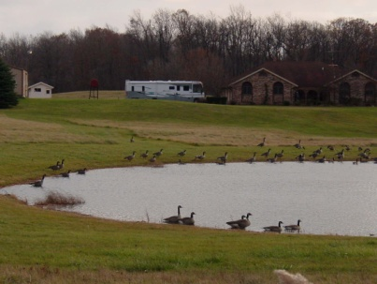
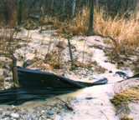
Why is stormwater a problem?
Pollutants fall on paved surfaces & lawns…
Storm drain discharges to waterway…
…resulting in water quality problems…
Runoff enters storm drain…
Dirt, oils, metals, salts
…and impairment of aesthetic & recreational values
Animal waste, fertilizers, pesticides
Dirt from construction sites

Slide 19

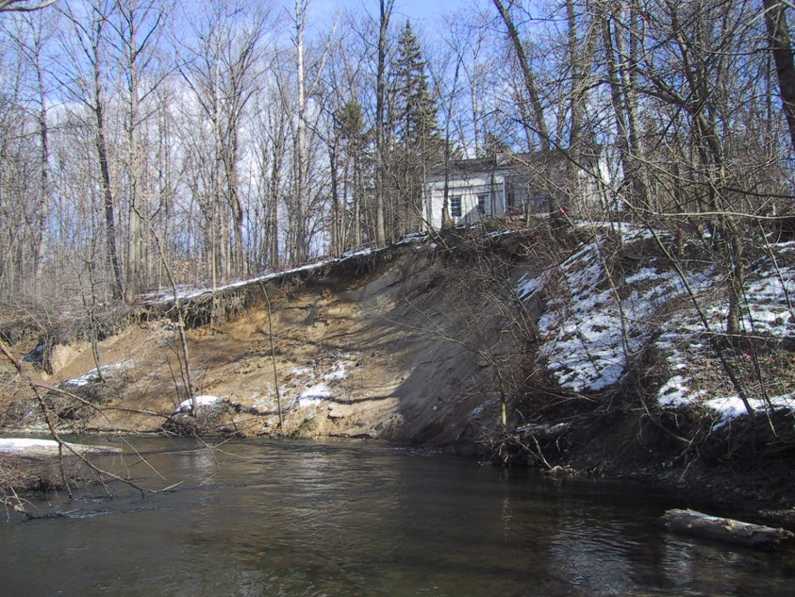
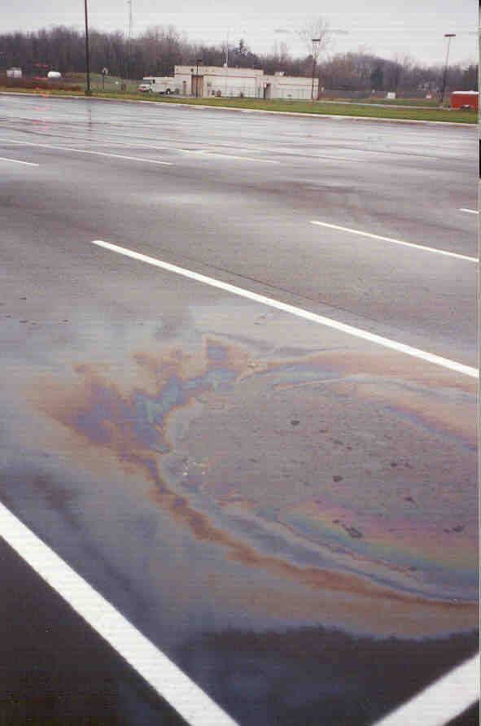
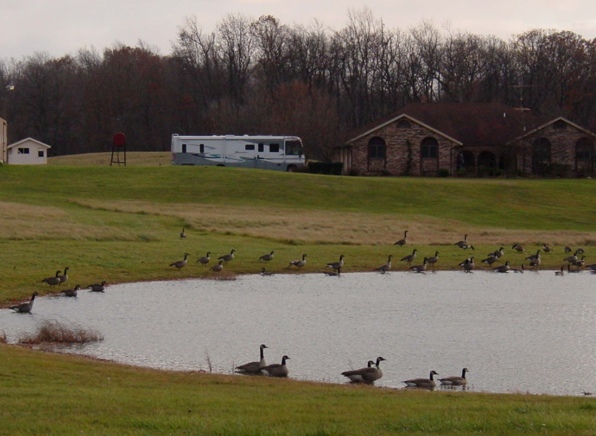
The many faces of
stormwater pollution…
Erosion & sedimentation
Grease, oils &
metals
Bacteria & nutrients

Slide 20
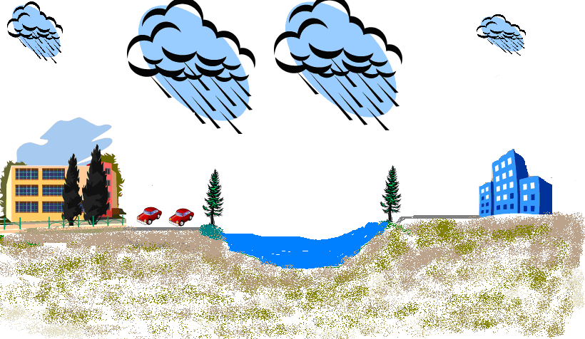

Impervious Surfaces and runoff
Notes:
20
In an urban environment where does runoff go can he concrete absorb it? What if there are no bodies of water around do parking lots and roads just flood? See if you can get the students to come up with storm drains if not go to next slide

Slide 21
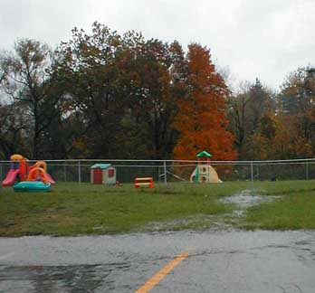
Imperviousness Increases Stormwater Runoff
1) The rooftops under which we live, work, and shop, and the transport system (roads, driveways, and parking lots) that we use to get from one roof to another are impervious surfaces (water can’t absorb through them).

Slide 22

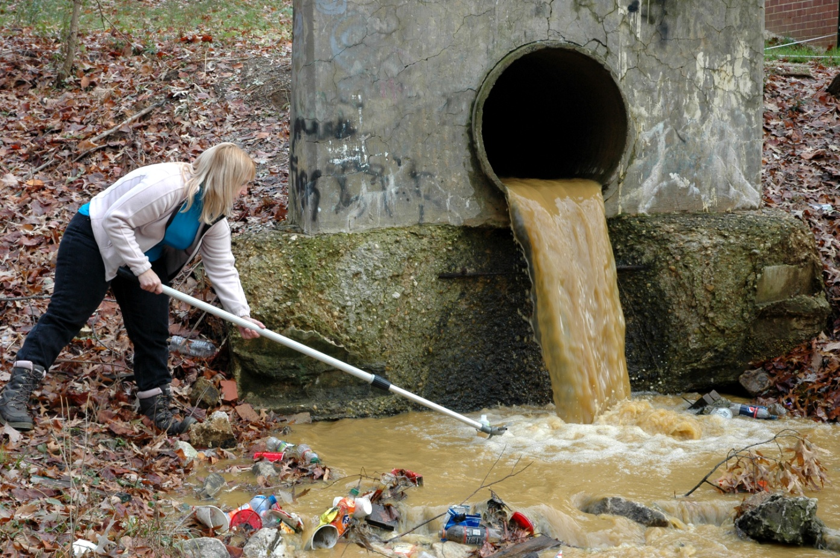
Stormwater can turn a
healthy river…
…into an unhealthy one.

Slide 23
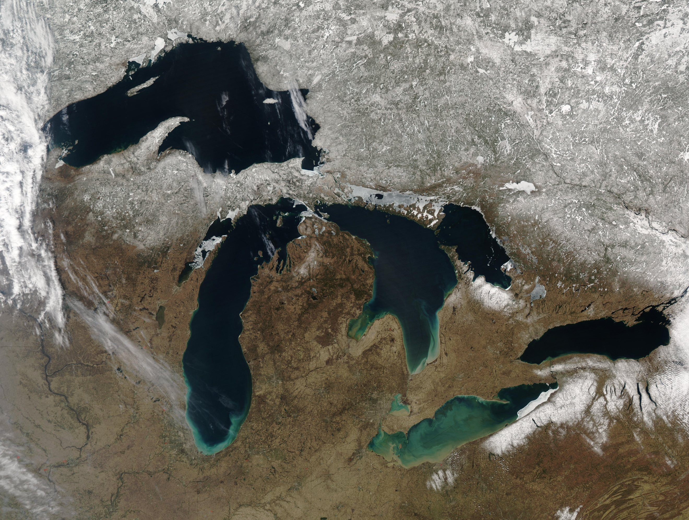
They connect to the
Great Lakes…

Slide 24
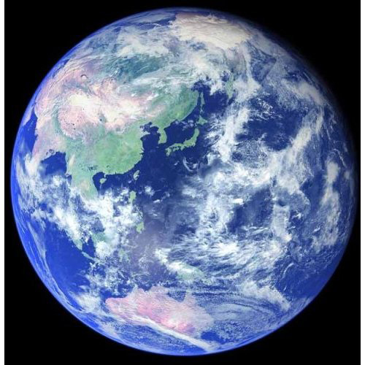
…And to the rest of the World

Slide 25
So what can we do to limit this impact?

Slide 26
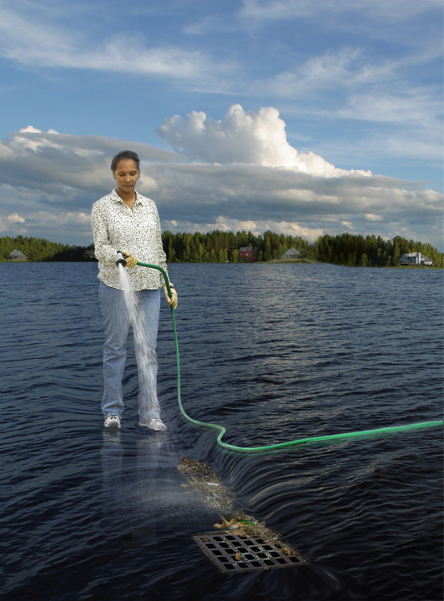
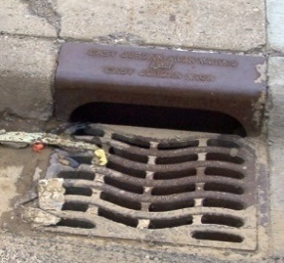
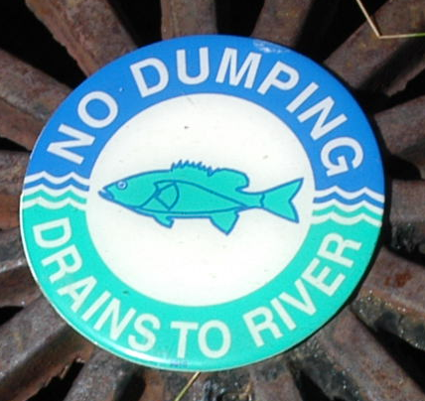
Don’t dump anything down storm drains
Don’t use pesticides/fertilizers, or sparingly use
Use car wash or wash on grass.
Pick up animal waste.
Don’t litter
Native plants
Rain barrel
Sweep, don’t hose
Dispose of hazardous chemicals properly
Label storm drains
Notes:
The important thing to remember….is that whatever goes into our storm drains flows into our lakes and streams. See this picture. This is a woman hosing her trash into the storm drain. The storm drain is on the water. In real life, it may not look like this, but it’s the same thing.

Slide 27
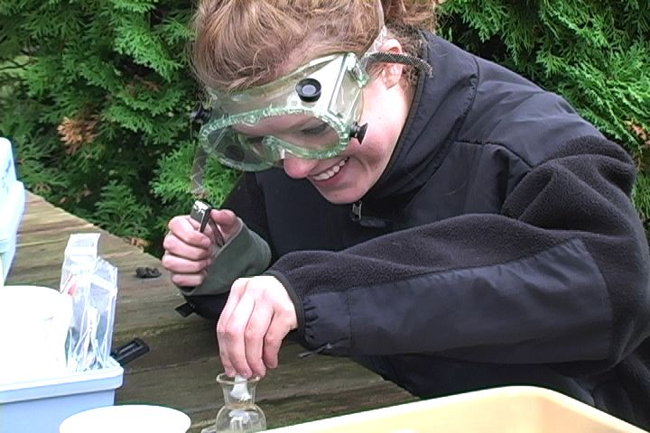
Stream Leaders Program Overview

Slide 28
So Why Should We Monitor Streams?
  1. To understand and keep watch of the impacts humans can have in their watersheds.
  2. Once data is collected, people can use the data to monitor future changes and to help correct negative impacts we may have imposed.
  3. Michigan streams are part of the Great Lakes Basin (big watershed).
  4. To educate you (students) about the importance of this precious resource.
Notes:
First explain some reasons for why people monitor water quality.

Slide 29
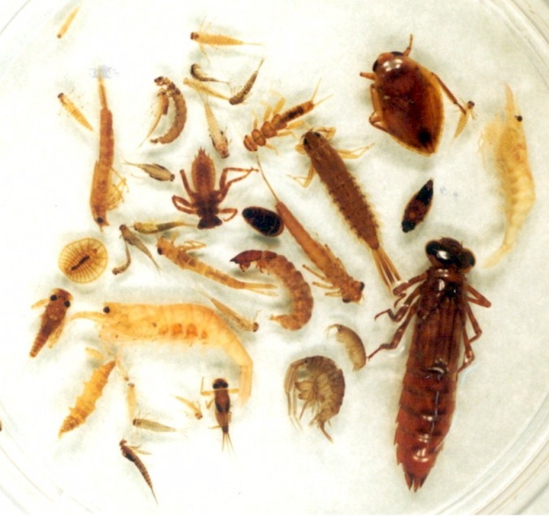
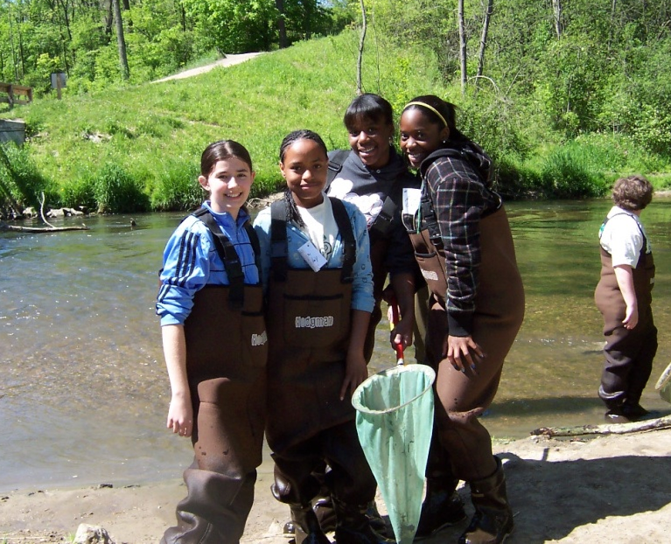
What do We Monitor?
  1. Physical Assessment
  2. Biological Indicators
  3. Water Chemistry
Notes:
Explain we measure 3 different aspects or parameters of a stream. Physical and Biological: briefly explain these parameters, but let them know we will talk about it more the next time we are in. Water Chemistry: This is our focus today.

Slide 30
Physical Habitat Monitoring Overview
Notes:
Explain we measure 3 different aspects or parameters of a stream. Physical and Biological: briefly explain these parameters, but let them know we will talk about it more the next time we are in. Water Chemistry: This is our focus today.

Slide 31
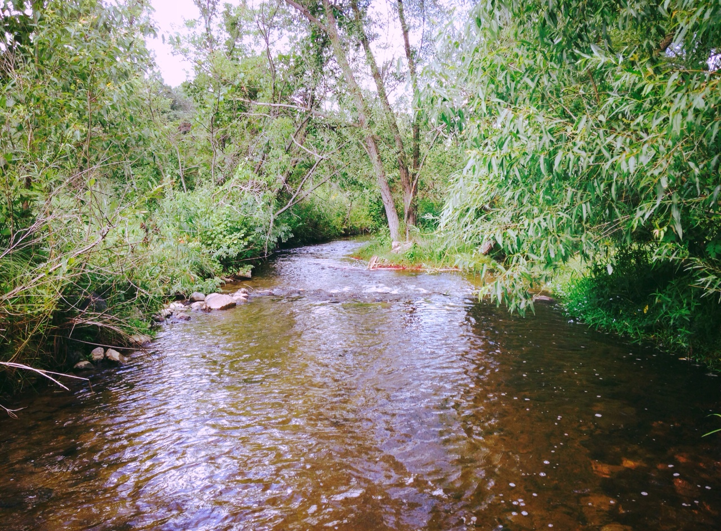
Stream Width
Estimate the width of the wet bank.
Notes:
Explain we measure 3 different aspects or parameters of a stream. Physical and Biological: briefly explain these parameters, but let them know we will talk about it more the next time we are in. Water Chemistry: This is our focus today.

Slide 32
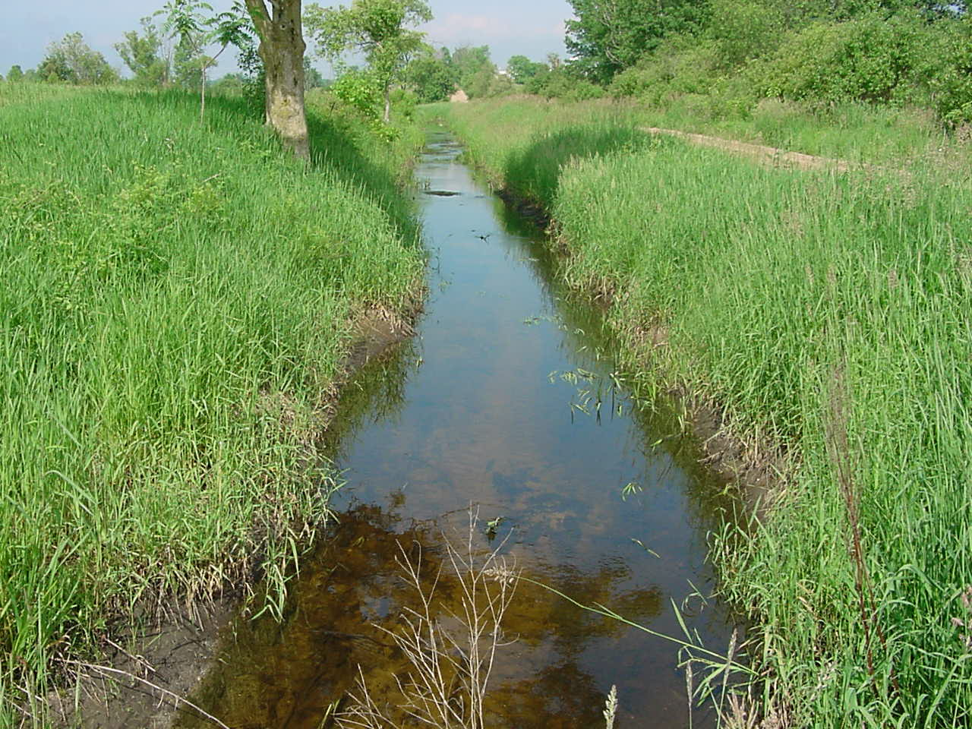
Channelized?
Notes:
Explain we measure 3 different aspects or parameters of a stream. Physical and Biological: briefly explain these parameters, but let them know we will talk about it more the next time we are in. Water Chemistry: This is our focus today.

Slide 33
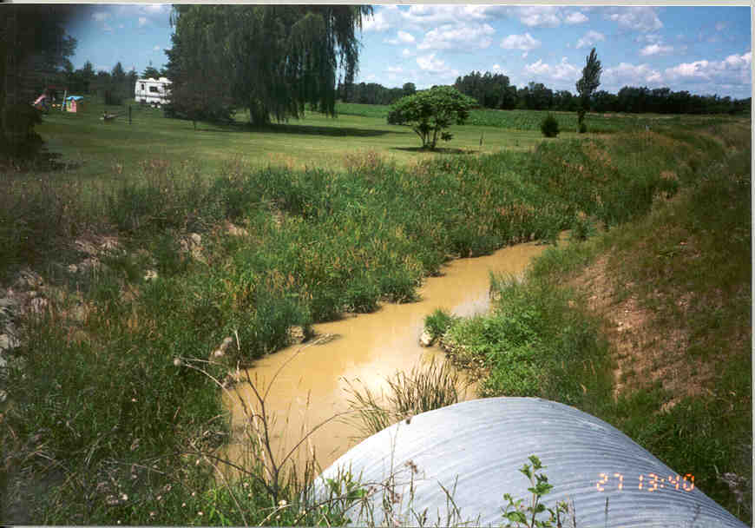
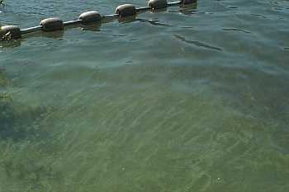

Water Color
Brown
Green
Grey
Notes:
Explain we measure 3 different aspects or parameters of a stream. Physical and Biological: briefly explain these parameters, but let them know we will talk about it more the next time we are in. Water Chemistry: This is our focus today.

Slide 34

Substrate Composition
SUBSTRATE (add to 100%)
% Boulder (<10”) % Cobble (2”-10”) % Gravel (1/4”-2”) % Sand (1/16”-1/4”) Artificial - manmade

Slide 35


Substrate Examples

Slide 36

Embeddedness
*
    The amount of sediment deposited on a rocky substrate

Slide 37


Riparian Vegetation
*
    The area of vegetation between land and a river or stream.

Slide 38


Stream Shading
Undercut banks
Overhanging branches

Slide 39



Bank Erosion
    Water wearing away at the banks of a stream or river
*
Moderate
Severe
Low

Slide 40

Stream Habitat
Run
Riffle

Slide 41

Aquatic Plants
    At healthy levels, it provides cover for small animals such as aquatic insects, snails, and scuds, which are valuable fish food...
*
    Excessive growth depletes the dissolved oxygen in the water and is a major contributor to fish deaths.
*
Filamentous Algae

Slide 42


Aquatic Plants
*
Duckweed
    Vascular plant! Not to be considered floating algae.
*
    The genus Wolffia has the smallest flower in the world!
    when nitrogen and phosphorous levels are high, these plants can completely take over the surface of the water, blocking out light, and lowering the oxygen levels in the water.
*
Floating Algae

Slide 43


Land Use
Main Branch Clinton River
North Branch Clinton River
ADJACENT LAND USES
Wetlands
Shrub or Old Field
Forest
Pasture
Crop Land
Animal Feeding Operation
Maintained Lawn
Impervious Surfaces
Disturbed Ground
No Vegetation

Slide 44






Examples of Adjacent Land Use

Slide 45




Aquatic Macroinvertebrates

Slide 46



What are Benthic Macroinvertebrates?
Benthic = bottom level (of a body of water)
Macro = large enough to be seen with the unaided eye
Invertebrate = without a backbone
Commonly referred to as: macros, benthos or bugs

Slide 47
Why are Macroinvertebrates good indicators of stream health?
live in the water for all or most of their life
stay in areas suitable for their survival
are easy to collect
are easy to identify in a laboratory
often live for more than one year
have limited mobility
differ in their tolerance to amount of pollution
are indicators of environmental condition
!
!

Slide 48


Macroinvertebrates
Often go unnoticed because of their size and habitat
Extremely important to a river ecosystem
  Primary food source for fish

Slide 49







Macroinvertebrates: Group 1
  Pollution sensitive organisms found in good quality water
*
Stonefly
Caddisfly
Water Penny
Riffle Beetle
Mayfly
Dobsonfly
Gilled Snail

Slide 50









Macroinvertebrates: Group 2
  Somewhat pollution tolerant organisms found in good or fair quality water
*
Crayfish
Sowbug
Dragonfly
Damselfly
Fishfly
Alderfly
Cranefly
Beetle
Net-spinning Caddisfly

Slide 51






Macroinvertebrates: Group 3
  Pollution tolerant organisms found in any quality of water
*
Aquatic Worm
Midge fly
Black fly
Leech
Pouch/Pond snail
Other snails

Slide 52



Equipment

Slide 53

All Found in our Rivers, Streams and Lakes!

Slide 54
Chemical Analysis
Dissolved Oxygen
Biochemical Oxygen Demand (BOD)
Coliform Bacteria
Nitrate
pH
Phosphate
Temperature
Turbidity
We will be measuring 8 different aspects of the water:
Sounds Fun Right?!
Notes:
Just give them the list of the different parameters. You can explain them more in depth in the next couple slides.

Slide 55

Dissolved Oxygen (DO): Required for respiration by
various types of aquatic life. Optimal levels are 5 – 7ppm
*
    Percent Saturation: Colder water holds more Oxygen.
Biochemical Oxygen Demand (BOD): the quantity of dissolved oxygen used by bacteria.
Coliform Bacteria: Occurs naturally at low to no levels. Sources are from fecal contamination.
Nitrates: Nutrient for plant growth. Optimal levels are
< 4ppm
Notes:
Demonstrate as many tests as you want (time permits). I would recommend to have a student assist just because the subject of water quality chemistry is not the most interesting to 9th graders.

Slide 56



pH: Optimal levels are 6.5-8.2
Total Phosphate: Nutrient for plant growth. Optimal level is
< 0.03ppm
Turbidity: Measurement of the relative clarity of the water
Water Temperature: < 20ºC is the optimal temp for sensitive macroinvertebrates, trout, and other cold water species
Notes:
Explain the importance and significance of each of these parameters. Might want to tell them what ppm stands for (parts per million).

Slide 57
Data Sheets:
Chemical →
Notes:
Just go over the chemical data sheet briefly. Emphasize that it is not a worksheet, but just a way to track your results from your tests.
Next time we are here we will be going over the physical assessment and the biological monitoring.

Slide 58

Questions?

