Slide 1
Chemistry-Part 3 Notes Chemical Equations & Reactions

Slide 2
What are Chemical Reactions?
Occur when bonds between the outermost parts of atoms are formed or broken.
Involve changes in matter, the making of new materials with new properties, and energy changes.
Symbols represent elements, Formulas describe compounds, and Chemical Equations describe a chemical reaction.

Slide 3
Parts of Chemical Reactions
Show the conversion of reactants (the molecules put into a reaction, on the left side of the arrow) into products (the molecules produced by the reaction, on the right side of the arrow).
A + sign separates molecules on the same side.
The arrow is read as yields.
Ex: C + O₂ → CO₂ is read as:
Carbon plus Oxygen react to yield Carbon Dioxide.

Slide 4
Parts of Chemical Reactions
Symbols used in equations include:
Solid (s) Aqueous Solution (aq) Liquid (l) Gas (g)
Subscripts vs. Coefficients
The Subscript tell you how many atoms of a particular element are in a compound.
The Coefficient tells you about the quantity, or number of molecules in the compound.

Slide 5
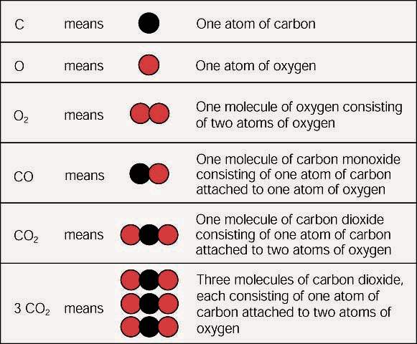
Parts of Chemical Reactions

Slide 6
Balancing Chemical Equations
In a chemical reaction, matter is neither created nor destroyed.
The number and type of atoms going into a reaction must be the same as the number and types of atoms coming out.
-If the equation obeys the Law of Conservation of Mass, it is balanced.

Slide 7
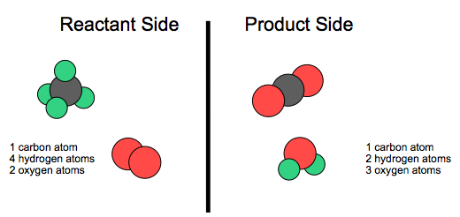
Unbalanced Chemical Equations
CH₄ + O₂ → CO₂ + H₂O

Slide 8
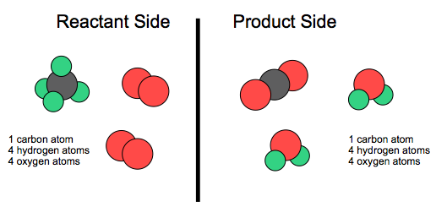
Balanced Chemical Equations
CH₄ + 2O₂ → CO₂ + 2H₂O

Slide 9
Example
___KClO₃ → ___KCl + ___O₂

Slide 10
Example
__C₂H₆ + __O₂ → __CO₂ + __H₂O

