Slide 1
Astronomy-Part 3 Notes Characteristics of Stars

Slide 2
What are Stars?
Hot balls of plasma that shine because nuclear fusion (hydrogen to helium) is happening at their cores. They create their own light.
Have different characteristics which allow many different ‘varieties’ of stars to exist
Variations in Luminosity and Color
Red
Yellow
Blue

Slide 3
Characteristics of Stars
Luminosity-How bright a star is.
Apparent Magnitude-How bright a star appears on Earth.
Stars can appear to be the same brightness to us on Earth even though they may not be (one may be farther away from us than the other).
Absolute magnitude – the actual brightness of a star.
Stars that are as bright as our Sun have a luminosity of 1
If a star has a luminosity of 50, it is 50 times brighter than our Sun

Slide 4
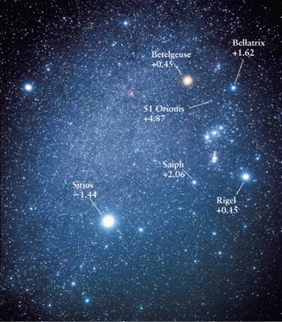
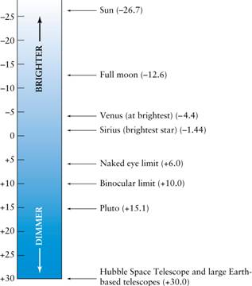
Apparent Magnitude
Brightness of stars, as seen from Earth.
Several stars in and around the constellation Orion labeled with their names and apparent magnitudes
Astronomers give the
brightness of objects in the sky by apparent magnitudes. Stars visible to the naked eye have magnitudes between m = –1.44 and about
m = +6.

Slide 5
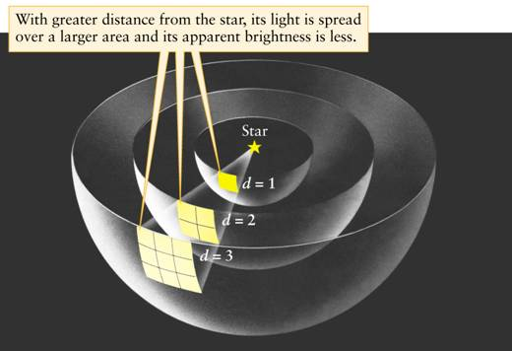
The Inverse-Square Law
The farther a star is from Earth, the dimmer it looks to us. Doubling the distance makes the star look one-fourth as bright. Tripling the distance decreases the star’s brightness by a factor of 9.

Slide 6
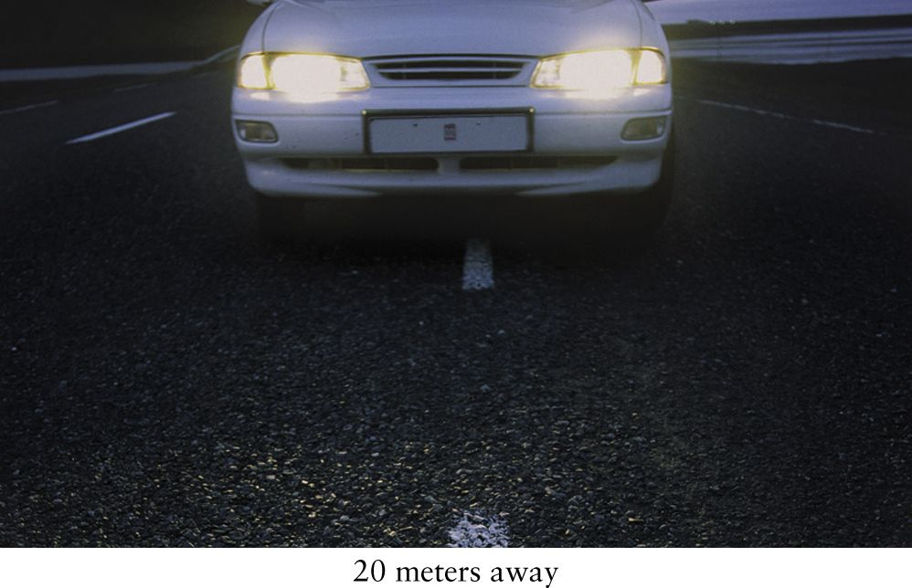
Absolute Magnitude
Tells how bright a star actually is, no matter how far from Earth it is.

Slide 7
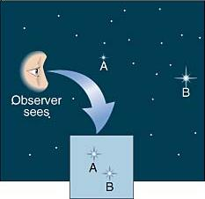
Absolute vs. Apparent Mag.

Slide 8
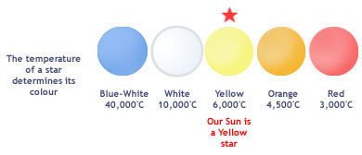
Color
The temperature of a star determines the color.
Hottest- Blue Color
Medium-Orange/Yellow
Coolest-Red

Slide 9
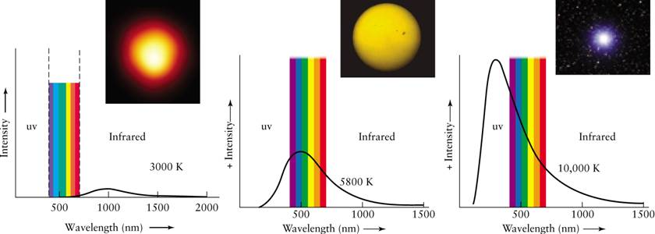
Color
Determined by wavelength of visible light emitted.
Shortest Wavelength-Violet
Longest Wavelength-Red

Slide 10
Electromagnetic Waves
Formed by changing electric fields and magnetic fields.
Do not require a medium to propagate.
This means that electromagnetic waves can travel not only through air and solid materials, but also through the vacuum of space.

Slide 11
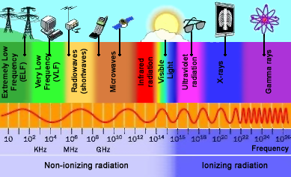
Electromagnetic Spectrum
Covers all energies of electromagnetic waves, from low-energy radio waves and microwaves, to infrared, to optical light, to ultraviolet, to high energy X-rays and Gamma Rays.

Slide 12
Visible Light Spectrum
Very small portion of the Electromagnetic Spectrum
White light can be split up into individual colors easily, forming the rainbow.
Continuous spectrum shows different energies of visible light.

Slide 13
Visible Light Spectrum and Chemistry
Each element in the Periodic Table can appear in gaseous form and will produce a series of bright lines unique to that element.
Hydrogen will not look like Helium, which will not look like Iron, etc.
Astronomers can then identify what kinds of stuff are in stars from the lines they find in the star’s spectrum.

Slide 14
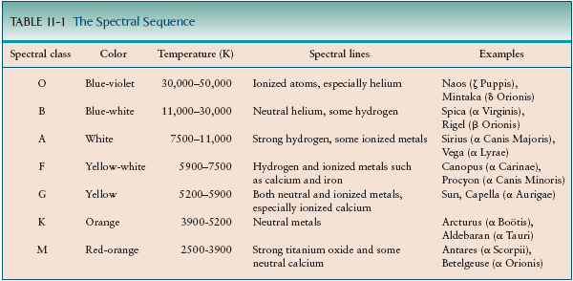
Color and Temperature
From spectral lines, scientists can determine not only the element, but the density and temperature of an element in the star.

Slide 15
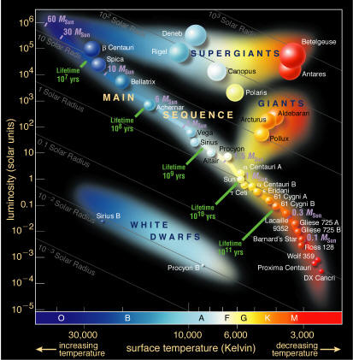
Relationship between Characteristics of Stars
Hertzsprung-Russell Diagram (HR)

Slide 16
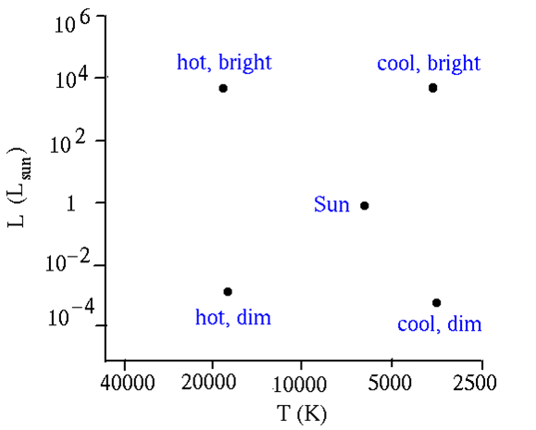
H-R Diagram
Star brightness is plotted against star spectral types (color/temperature).
Brightness and spectral type are related.
Main-sequence stars (fusing hydrogen to helium) fall along red curve.
Giants are to the upper right, and super giants are on top.
White dwarfs are below the main sequence.

Slide 17
Star Size
Hotter stars are brighter than cooler stars (at the same size).
Bigger stars are brighter than smaller stars (of the same temperature).
So the brightest stars are the biggest and hottest ones.
L=R²T⁴ (L=brightness, R=radius, T=temperature)

Slide 18
Mass-Temperature-Brightness
Each dot represents a main-sequence star.
The dot’s number is the mass of that star in solar masses (Sun = 1)
Mass, brightness, and temperature of main sequence stars increase from lower right to upper left.

Slide 19
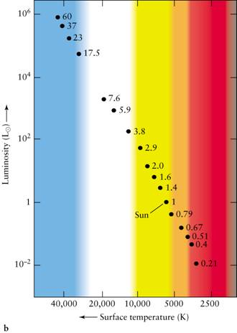

Slide 20
Relationships between Properties
Temperature and Color
Blue stars are hotter
Red stars are cooler
Luminosity and Color
Brighter stars are blue
Dimmer stars are red
Size and Luminosity
Bigger stars are brighter
Smaller stars are dimmer

Slide 21
Relationships between Properties
“The Main Sequence”
-Band of stars that stretches from the top left to the bottom right of the HR diagram
-Contains stars that are in the stable, main part of their life cycle, e.g. – our Sun
Stars that are not part of the Main Sequence are near the end of their lives
-Ex. White Dwarfs – they are white (so they are hot) but dim because they are small --- are cooling and will become black
-Ex. Red Giants – they are red (so they are cool) but bright because they are large --- will eventually explode

