Slide 1
Astronomy-Part 2 Notes Origins of the Universe

Slide 2
What is a Theory?
A theory is a hypothesis that contains evidence to support it.
It provides a framework for facts and observations.

Slide 3
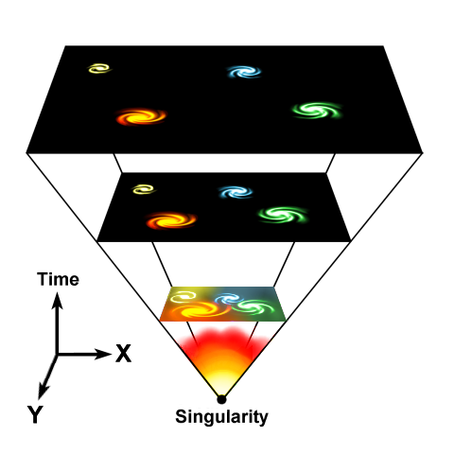
What is The Big Bang?
Theory that states that the Universe began to expand with the explosion of concentrated matter and energy.
After the “Big Bang”, the force of gravity began to affect the matter shooting outward in every direction.

Slide 4
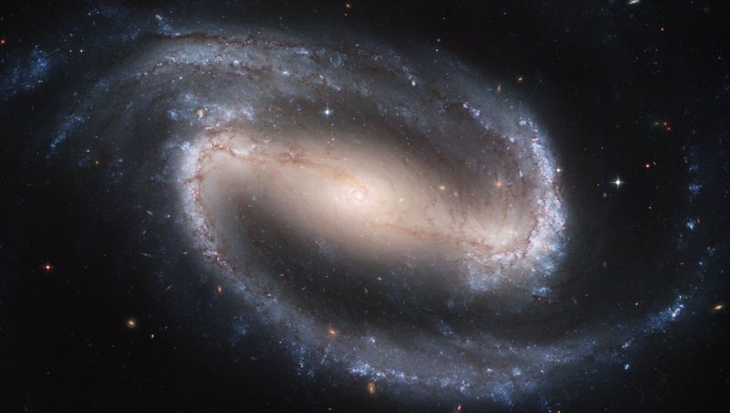
Big Bang Basics…
Gravity began to pull matter into clumps.
These clumps formed huge clusters which became galaxies of the universe.

Slide 5
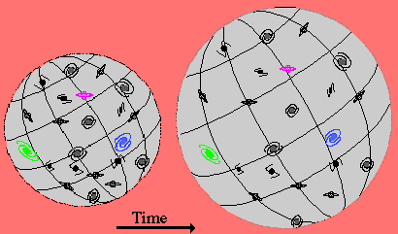
The Expanding Universe
In 1929, Edwin Hubble showed that most galaxies are red-shifted (moving away from us), and that a galaxy’s velocity is proportional to its distance (galaxies that are twice as far from us move twice as fast)

Slide 6
Predictions for the Big Bang Model
The expansion of the Universe
Edwin Hubble's 1929 observation that galaxies were generally receding from us provided the first clue that the Big Bang theory might be right.
The abundance of the light elements H, He, Li
The Big Bang theory predicts that these light elements should have been fused from protons and neutrons in the first few minutes after the Big Bang.
The cosmic microwave background (CMB) radiation
The early universe should have been very hot. The cosmic microwave background radiation is the remnant heat leftover from the Big Bang.

Slide 7
Evidence for the Big Bang
Red shift - as light from distant galaxies approach earth there is an increase of space between earth and the galaxy, which leads to wavelengths being stretched
In 1964, Arno Penzias and Robert Wilson, discovered a noise of extraterrestrial origin that came from all directions at once - radiation left over from the Big Bang
In June 1995, scientists detected helium in the far reaches of the universe - consistent with an important aspect of the Big Bang theory that a mixture of hydrogen (75%) and helium (25%) was created at the beginning of the universe

Slide 8
History of the Universe
The universe begins ~13.7 Billion years ago
The universe begins as the size of a single atom.
All matter and space were created from a single point of pure energy in an instant.
How do we know?
Spreading (Red Shift) -know distances, rates of retreat, relative positions
Pervasive background radiation of 2.7°C above absolute zero - afterglow of the Big Bang

Slide 9
History of the Universe
3 Minutes after The Big Bang
The universe has grown from the size of an atom to larger than the size a grapefruit
E=mc²
Energy froze into matter according to Albert Einstein’s equation.
This basically says that like snowflakes freezing, energy forms matter into clumps that today we call protons, neutrons and electrons.
These parts later form into atoms.

Slide 10
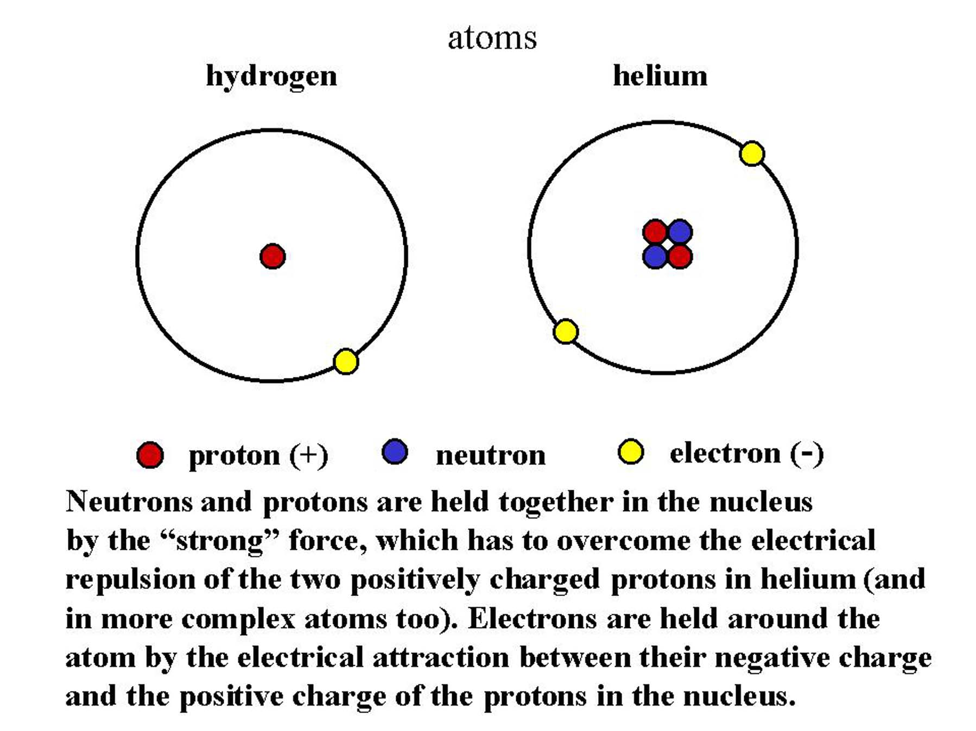
History of the Universe
Three Hundred Thousand Years after The Big Bang
Atoms form (specifically Hydrogen and its isotopes with a small amount of Helium.)
The early Universe was about 75% Hydrogen and 25% Helium. It is still almost the same today.

Slide 11
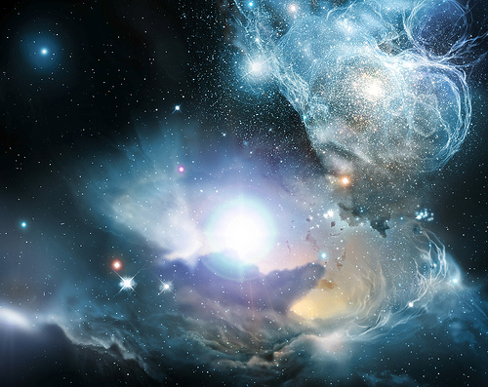
History of the Universe
200-400 Million Years after The Big Bang
First stars and galaxies form.

Slide 12
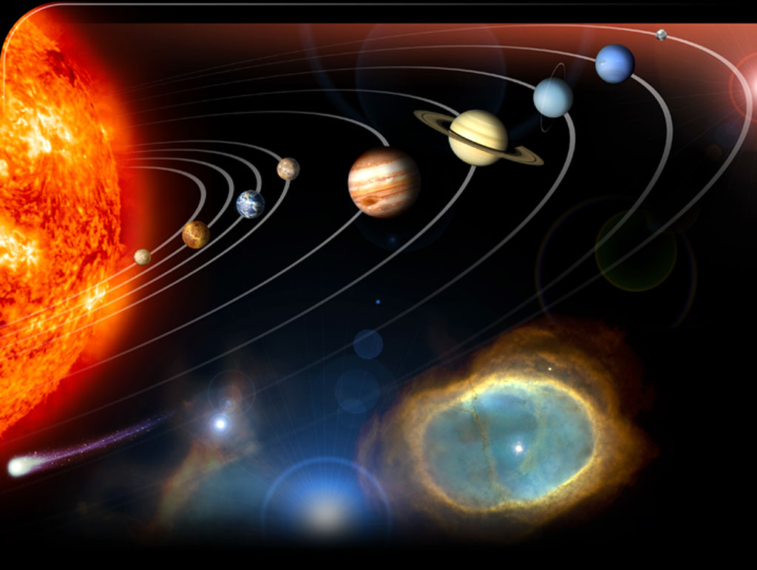
History of the Universe
4.6 Billion Years Ago
Our Solar System Forms

Slide 13
Misconceptions about The Big Bang
There was no explosion; there was (and continues to be) an expansion
Rather than imagining a balloon popping and releasing its contents, imagine a balloon expanding: an infinitesimally small balloon expanding to the size of our current universe
We tend to imagine the singularity as a little fireball appearing somewhere in space
space began inside of the singularity. Prior to the singularity, nothing existed, not space, time, matter, or energy - nothing.

