Slide 1
Astronomy-Part 5 Notes:
Constellations

Slide 2
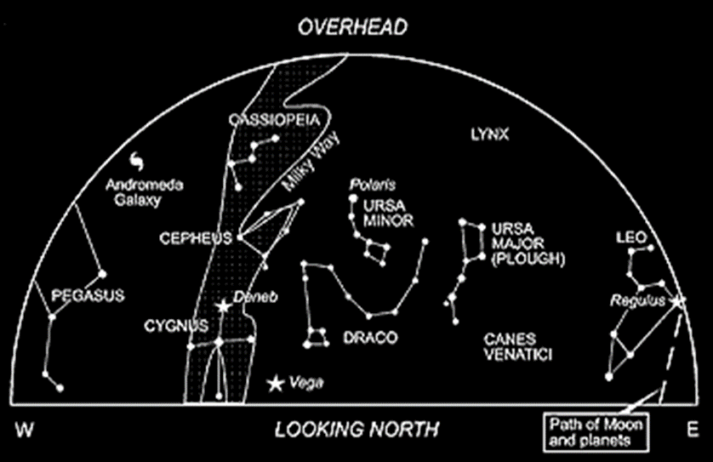
What are Constellations?
Group of stars that appear to form a pattern in the sky.
88 recognized by International Astronomy Union
The constellations you see depend on date, time, and location.

Slide 3
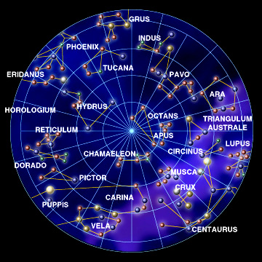
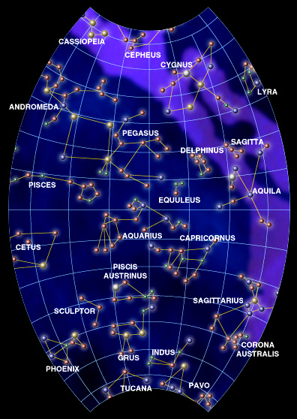
Different Hemispheres? Different Constellations.
Southern Hemisphere Northern Hemisphere

Slide 4
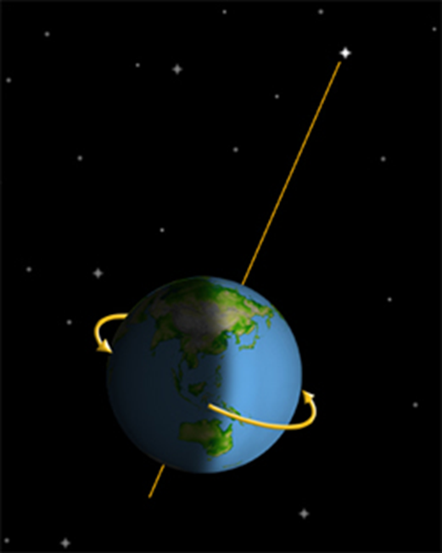
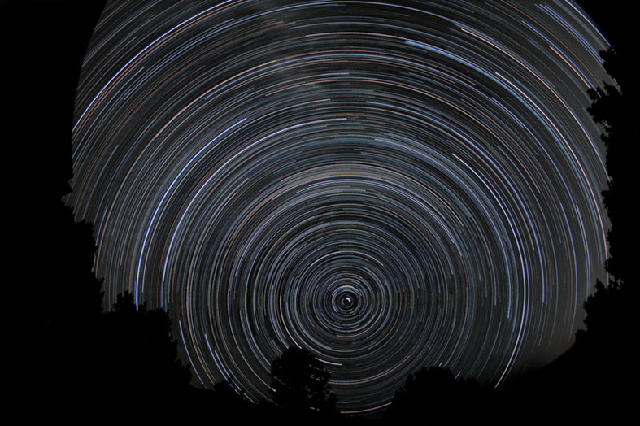
Polaris
As the Earth rotates on its axis its “celestial” north pole remains directly in line with Polaris.
Stars in the northern hemisphere appear to rotate around Polaris (the north star)
Polaris aligns with the axis of rotation for the Earth: The North Pole

Slide 5
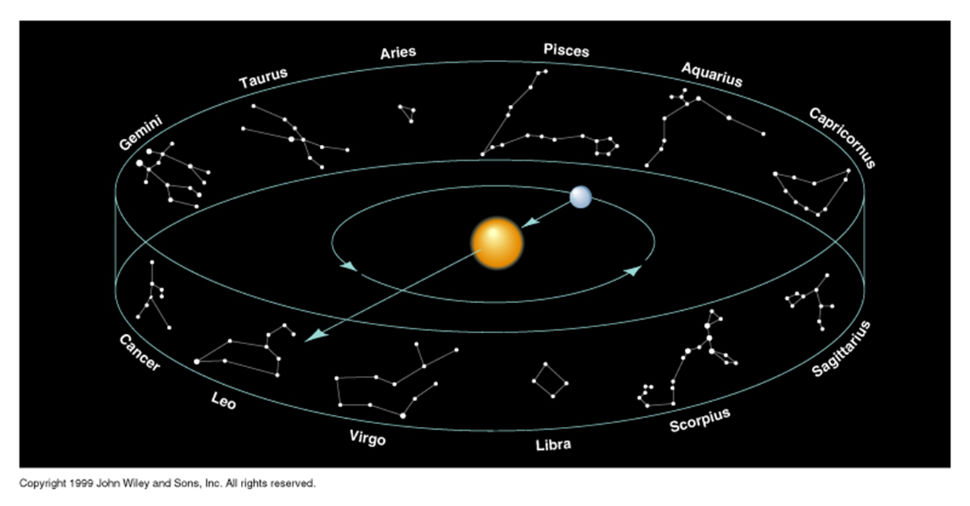
The Zodiac
Band of 12 constellations across the ecliptic.
The ecliptic is the plane of Earth’s orbit around the sun. It is the apparent path that the sun (and planets) appear to move along against the star background.

Slide 6
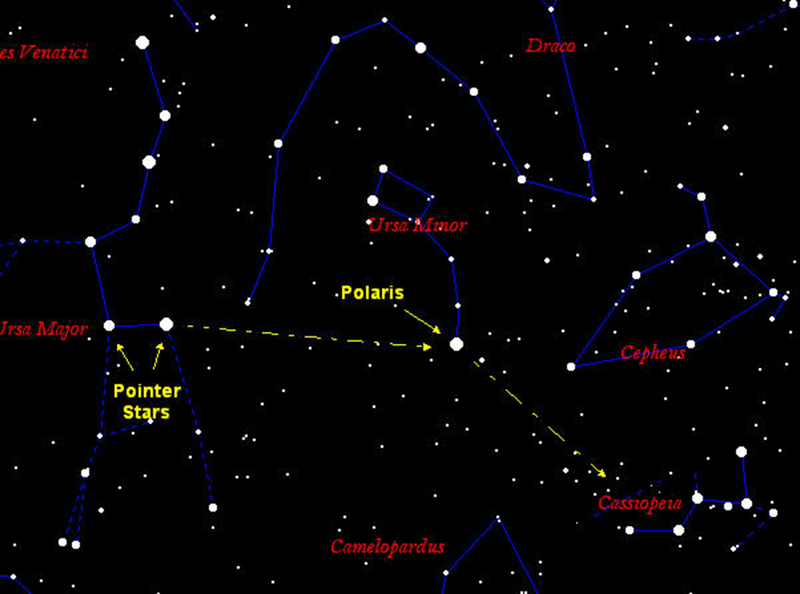
Circumpolar Constellations
Can be seen all year long
Never fully set below the horizon
Appear to move counter clockwise around Polaris
Caused by Earth’s Rotation

Slide 7
Examples of Circumpolar Constellations
    Ursa Major – The Big Bear
    Ursa Minor – The Little Bear
    Cassiopeia – Queen on Her Throne
    Draco- The Dragon
    Cepheus- The King

Slide 8
Examples of Circumpolar Constellations
The number of stars seen as circumpolar depends on the observer’s latitude
The further North the observer lives, the more stars will appear circumpolar
Earth turns west to east.
Sky appears to turn east to west.

Slide 9
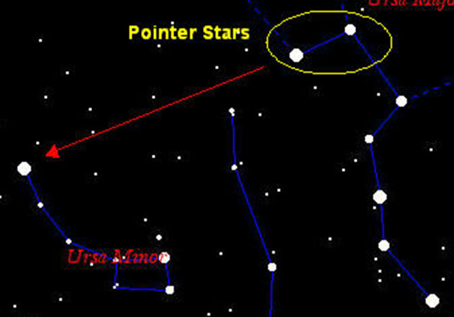
Ursa Major
Best known constellation
Common name is Big Dipper
Pointer stars- front 2 stars of the Big Dipper which point to Polaris (North Star)

Slide 10
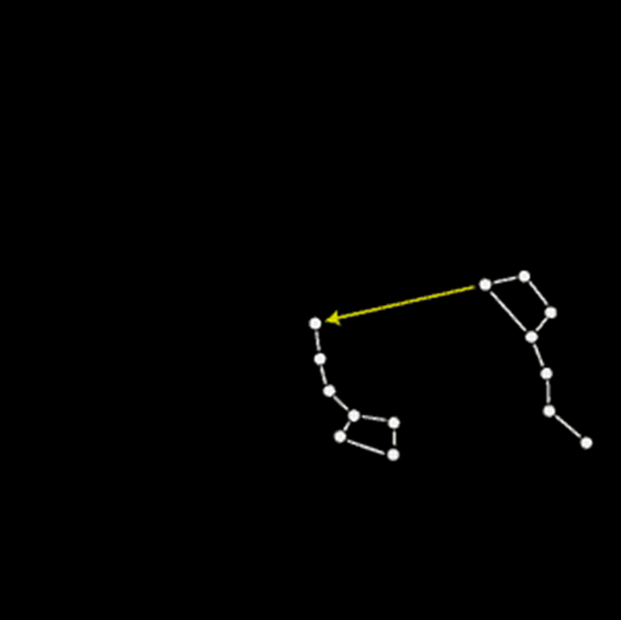
Seasonal & Nightly Changes
Big Dipper
  In Fall: Low over northern horizon
  Spring: High overhead
Cassiopeia
  In Fall: Straight overhead
  Spring: Low over northern horizon

Slide 11
The Seven Major Constellations
Cassiopeia Orion
Cygnus Ursa major
Scorpius Ursa minor
Draco

Slide 12
Cassiopeia – “ The Queen”

Slide 13
Cassiopeia – “The Queen”
Brightest Star – Schedar
Best season to view – all year
The Myth:
Cassiopeia was the queen of Ethiopia. She was so proud of her beauty and bragged about it. She offended the sea god Poseidon. He sent a sea monster to attack her kingdom and teach her some humility.
According to the legend, the sea god Poseidon placed the figure of Cassiopeia among the stars to remind people of her vanity.

Slide 14
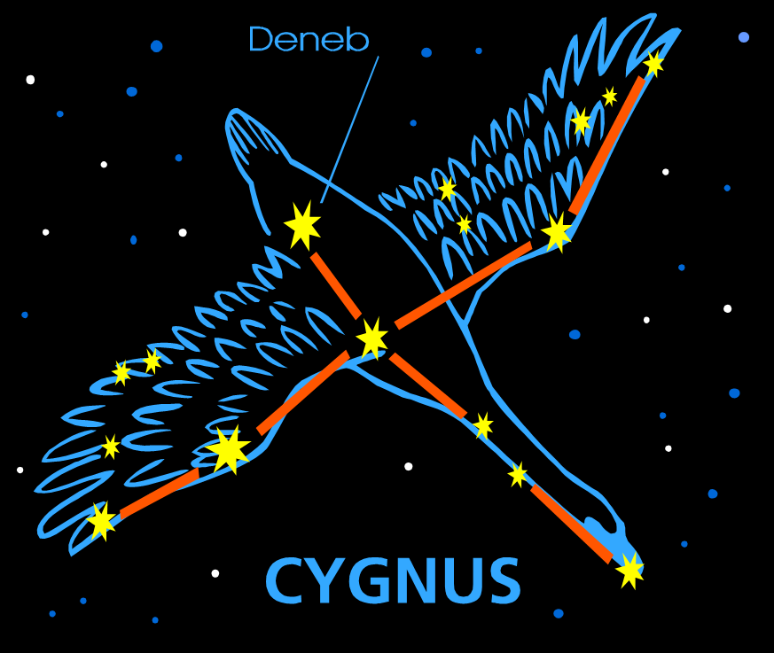
Cygnus-”The Swan”

Slide 15
Cygnus-”The Swan”
Brightest Star – Deneb
Best season to view – all year
The Myth:
One day three hunters were hiking through the forest when they came upon a clear lake. The lake was home to many birds including a beautiful snow goose. One hunter shot his bow and the snow goose fell into the lake. As the sky darkened, the spirit of the snow goose formed a constellation
in the sky.

Slide 16
Scorpius – “The Scorpion”

Slide 17
Scorpius – “The Scorpion”
Brightest Star – Antares
Best season to view – summer
The Myth:
To the ancient Greeks, the constellation Scorpius was the image of a scorpion. The constellation was related to the death of the giant hunter Orion. There are several different stories about Orion's death. According to one story, Orion wanted to kill all the earth's wild animals, but the Earth goddess Gaia got angry because she made the animals.
The goddess sent a scorpion to attack Orion. The scorpion stung Orion to death with its tail. As a reward, Gaia changed the insect into a constellation.

Slide 18
Orion-”The Hunter”

Slide 19
Orion-”The Hunter”
Brightest Star – Rigel and Betelgeuse
Best season to view – the winter
The Myth:
Orion was a very good hunter, but also boastful. Gaia, the goddess of Earth, became fed up with Orion’s boast so she sent a deadly scorpion to kill the hunter. The scorpion ended Orion’s bragging. Both Orion and Scorpius were placed in the sky but to avoid any further battles, they are never in the sky at the same time. Orion is seen in the winter and Scorpius is seen in the summer.

Slide 20
Ursa Major-”Big Bear”

Slide 21
Ursa Major-”Big Bear”
Brightest Star – Dubhe and Merak
Best season to view – all year
The Myth:
Zeus, king of the gods, fell in love with Callisto. Together they had a son, Arcas. Zeus changed Callisto into a bear to protect her from his jealous wife, Hera. When Arcas grew up, he almost shot his mother by mistake. Zeus protected Callisto by changing Arcas into another bear (Ursa Minor-Little Dipper) and placing both bears in the sky.

Slide 22
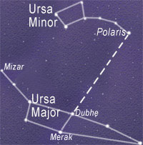
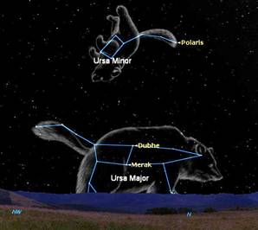
Ursa Minor-”The Little Bear”
Ursa Minor, aka, Little Bear, contains the Little Dipper and the North Star, Polaris

Slide 23
Ursa Minor-”Little Bear”
Brightest Star – Polaris
Best season to view – all year
Remember Zeus loved Callisto and changed her into a bear to protect her from his jealous wife. Arcas liked to hunt and almost killed his mother, Callisto, Big Bear. Zeus decided to also change Arcas into a bear to protect both his son and his lover. He placed both bears in the sky together.

Slide 24
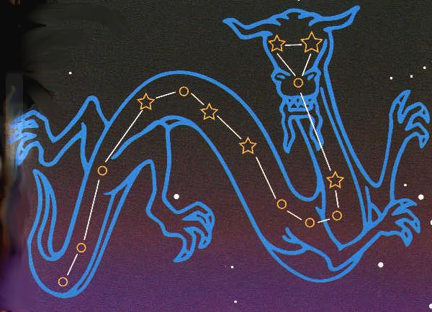
Draco-”The Dragon”

Slide 25
Draco-”The Dragon”
Draco the dragon fought Minerva during the wars between the giants and the gods. Minerva threw Draco's twisted body into the heavens before it had time to unwind itself.

